Slide 1
Salary Manager Calculator
CSC 1500 Final Project - Bryan Lor

Slide 2
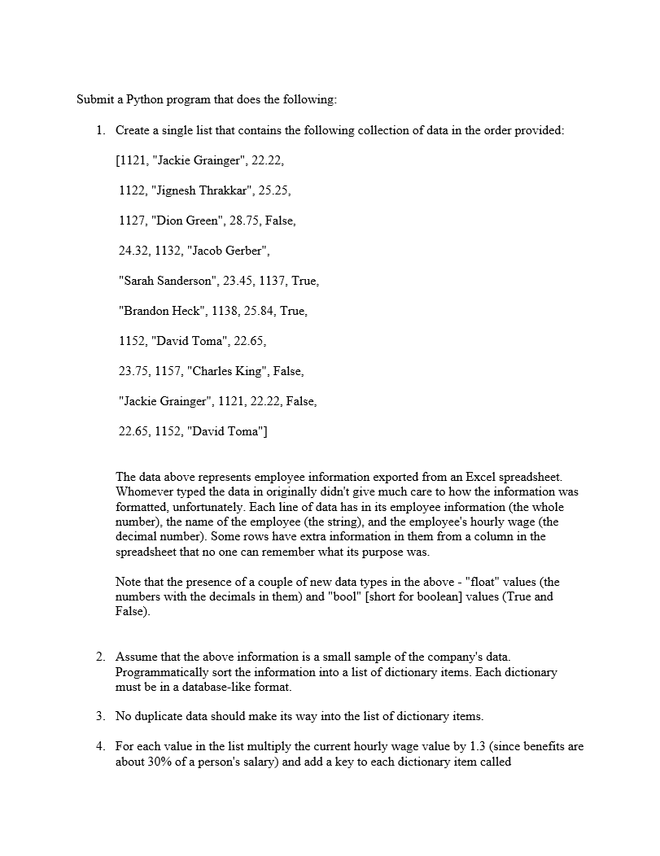
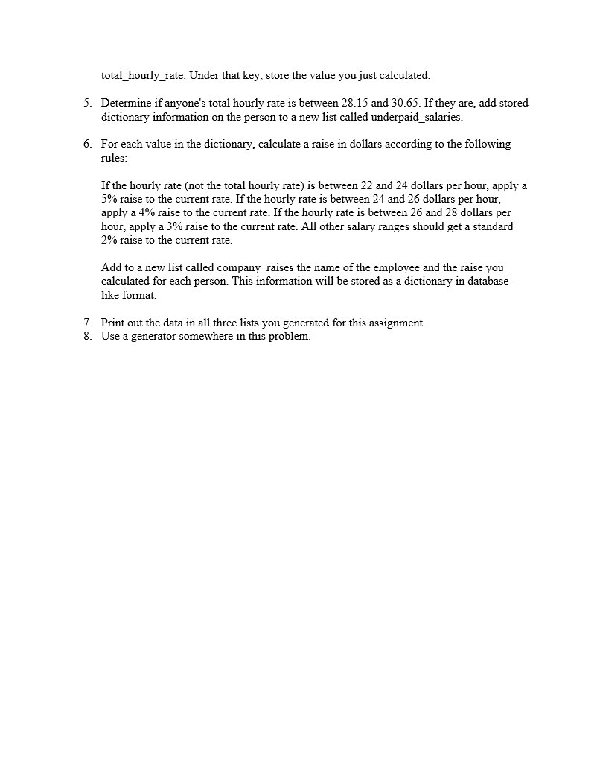
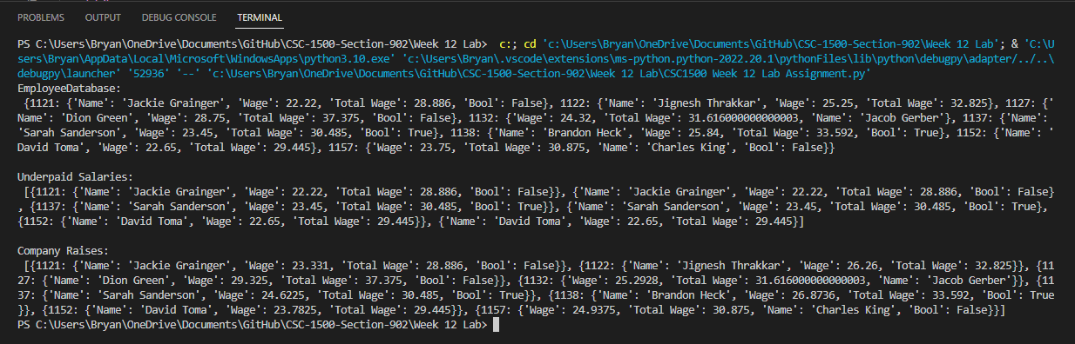
Old Software

Slide 3
Issues
File Importing
Graphical Interface
Product did not utilize actual excel files as it’s use case scenario.
A graphical interface was non-existent for the previous version.
Code Architect
File Exporting
Original product had poor code structure and organization.
Lack of file save and export system making product impractical for real world usage.

Slide 4
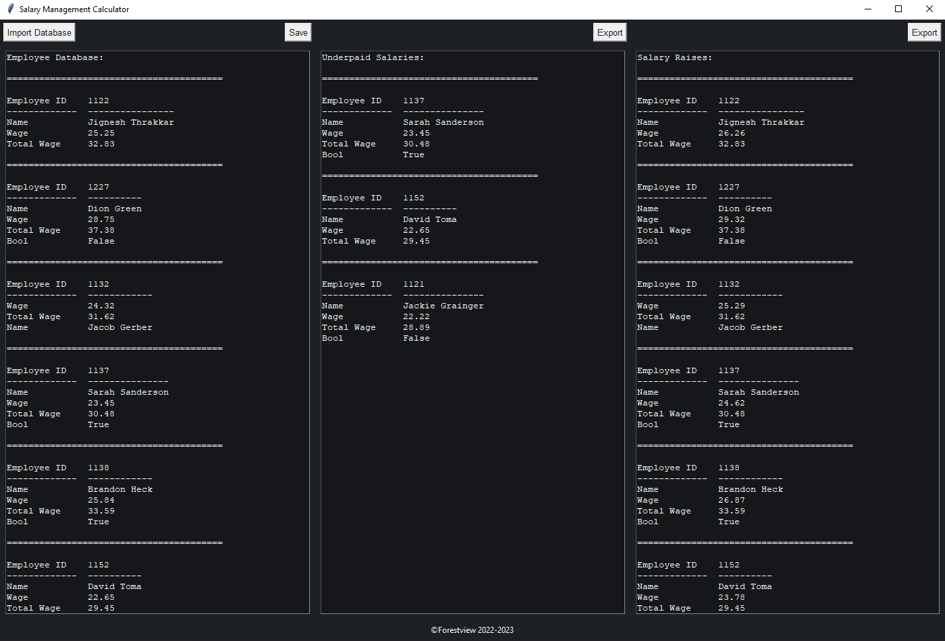
Updated Software
A complete overhaul of assignment 12 that encompasses modern features.

Slide 5
New Features
Graphical Interface
-Modernized Tkinter GUI
File Importing/Exporting
-Excel sheet information loading
-Excel sheet information exporting
Refactored Code
-Clean code architect with modular functions
-Object Orientated Programming
Libraries
-Tkinter -Itertools
-Pandas -Os

Slide 6

Graphical Interface
DESIGN
Modernized design utilizing a dark theme
Accessibility
Minimalistic and easy to use

Slide 7
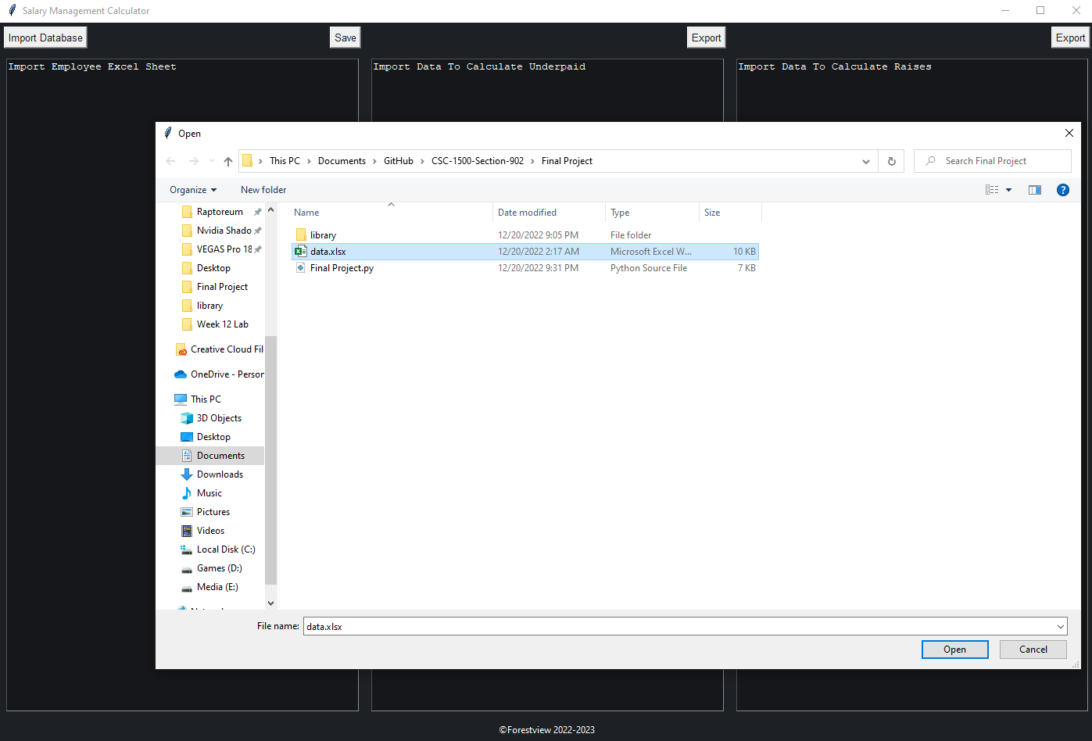
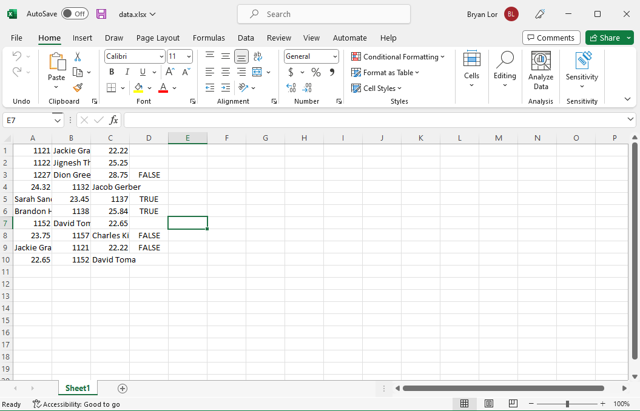
File Importing
Product follows the original guideline of opening an excel sheet and importing badly formatted data.

Slide 8
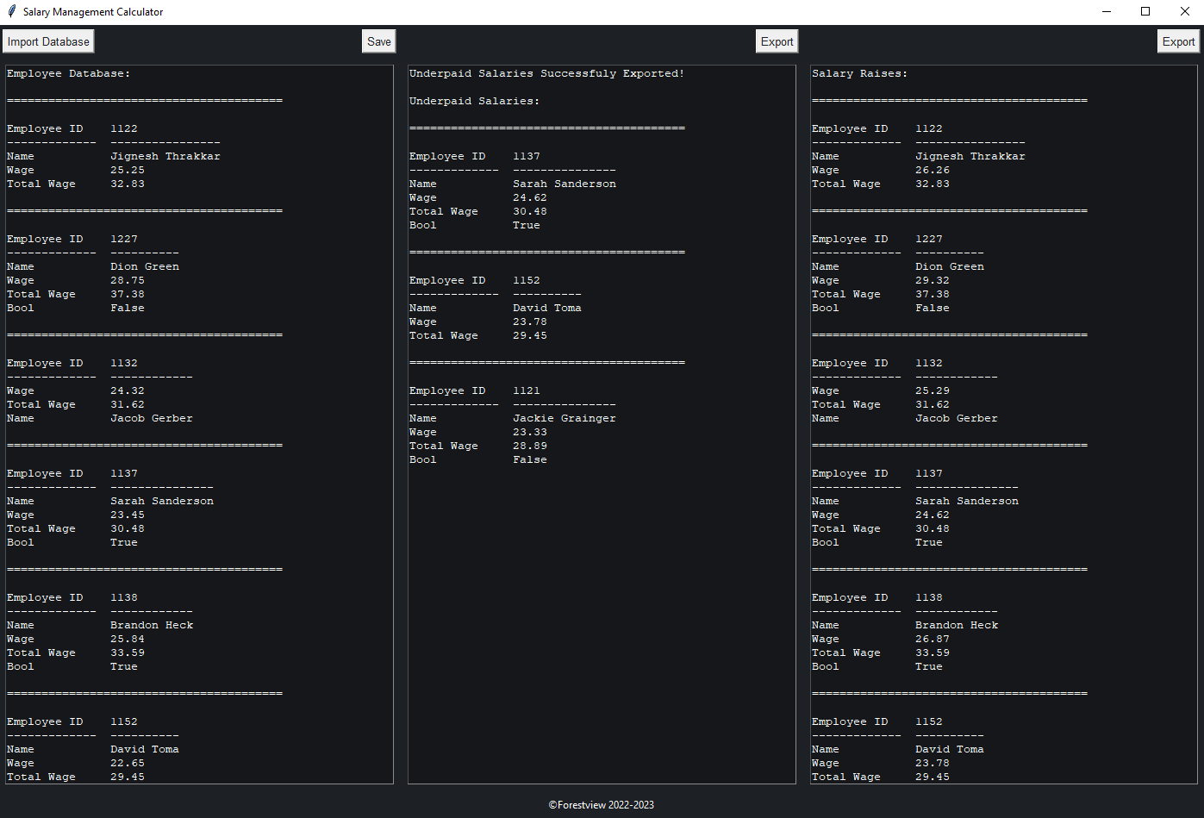
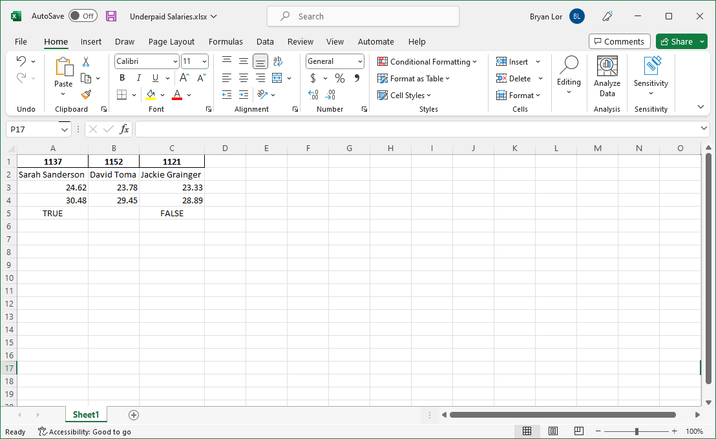
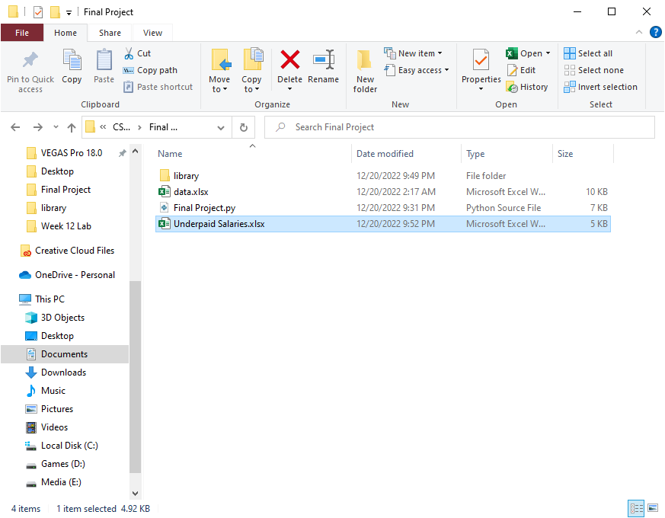
File Exporting
Additionally, users can also export the data into separate excel files for usage.

Slide 9
SUMMARY
Assignment 12 has been completely overhauled to now follow its prompt more practically. The newer software features a modern GUI alongside a complete file load and save system. As a result, the entire code base has been restructured into modularized functions that utilizes OOP.

Slide 10
THANK YOU
GitHub Link: https://github.com/Bryan-Lor/CSC-1500-Section-902/tree/main/Final%20Project
Bryan Lor​
hf3837@wayne.edu

